Slide 1


Pilot Study Review
Client: Exyte
Location: Singapore
Date : 20 Dec 2023

Slide 2
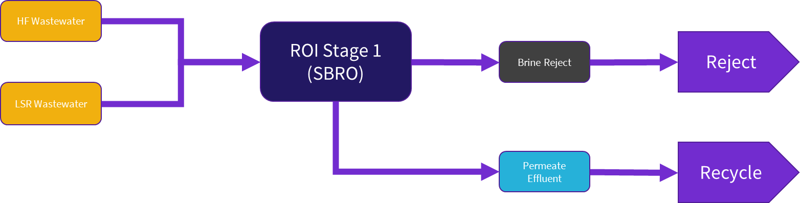
Overall Process Description

Slide 3
Objectives
Confirm water analysis of the raw samples
Confirm water analysis of the mixed sample
Confirm final brine quality
Check for any anomalies in water analysis such as high F, NO3, etc
Calculate the optimal mixing ratios
Calculate scaling potential
Calculate maximum recovery that can be achieved
Confirm ≥75% recovery
Confirm permeate water quality meets KPIs
Confirm operating pressures and flow rates

Slide 4
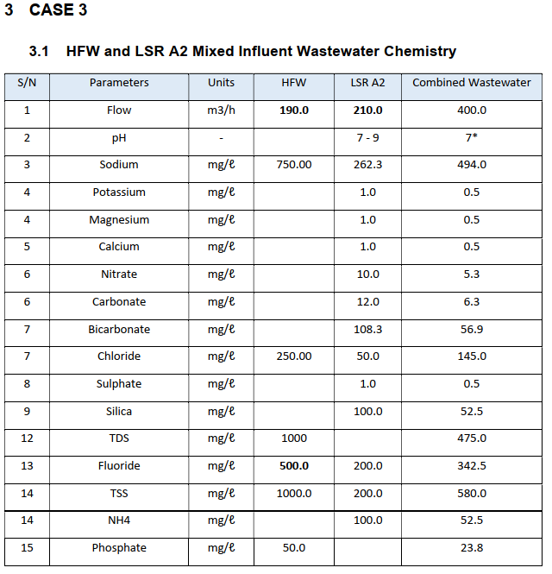
Target Operation
Design Basis will be adjusted depending on the received water quality

Slide 5
HFW and LSR sampling points – Run 1
Sampling points | Volume (L) | Total volume (L) | Frequency per week | Total quantity per week (L)
HFW
HFW Gravity Drain A1 | 48 | 100 | 10 | 1000 (1m³)
HFW Gravity Drain A2 | 48
HFW Gravity Drain Chem Room | 2*
HFW Gravity Drain Corrosive gas room | 2*
LSR A2
LSR A2 transfer pump | 100 | 100 | 10 | 1000 (1m³)
*Collect in two separate 20 L carboys and mixing will be done in GIH lab, LSR A1 feed is not required
Sample to be collected once per 12-hour shift

Slide 6
HFW and LSR sampling points – Run 2
Sampling points | Volume (L) | Total volume (L) | Frequency per week | Total quantity per week (L)
HFW
HFW Gravity Drain A1 | 192 | 400 | 10 | 4000 (4m³)
HFW Gravity Drain A2 | 192
HFW Gravity Drain Chem Room | 8*
HFW Gravity Drain Corrosive gas room | 8*
LSR A2
LSR A2 transfer pump | 400 | 400 | 10 | 4000 (4m³)
*Collect in 8x separate 20 L carboys and mixing will be done in GIH lab, LSR A1 feed is not required
Sample to be collected once per 12-hour shift

Slide 7
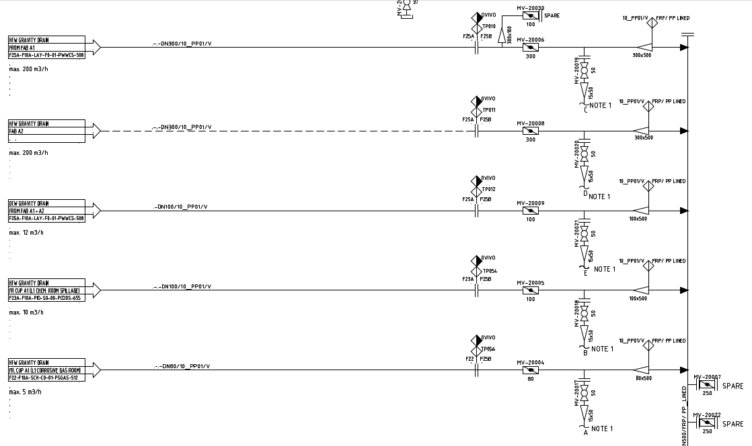

Slide 8
Sample analysis
Samples | Measured F (mg/L) 18 Aug | Volume (L) | Combined fluoride by calculation (mg/L)
HFW
HFW Gravity Drain A1 | 580 | 48 | 1076.6
HFW Gravity Drain A2 | 140 | 48
HFW Chem Room | 30857 | 2
HFW Corrosive Gas Room | 417 | 2
LSR
LSR A2 | 29.4 | NA | NA

Slide 9
Sample analysis
Samples | Measured F (mg/L) 18 Aug | Measured F (mg/L) 19 Aug, 6 am | Measured F (mg/L) 20 Aug, 6 pm | Measured F (mg/L) 21 Aug, 11 am
HFW Gravity Drain A1 | 580 | 454 | 422
HFW Gravity Drain A2 | 140
HFW Chem Room | 30,857 | 546 | 27,953 | 15,132
HFW Corrosive Gas Room | 417 | 422 | 540 | 407

Slide 10
Alternative proposal
Provision to divert Chem drain (due to high fluoride) to Eq tank 1 whenever there is a surge of fluoride in Eq tank 3
When fluoride in Eq tank 3 is high, HFW line will stop and LSR A1 diversion will begin
*Open for discussion*
EQ tank 1

Slide 11
Schedule
Items | Status | PO number | ETA
Membranes BW30 PRO-4040 | PO issued | POGIH22357 | 12 Jan
Pressure vessels | PO issued | POGIH22329 | 12 Jan
High pressure hose to upgrade existing setup | Pending delivery | COD | 10 Jan
Fittings | Procured and delivered | NA | NA

Slide 12
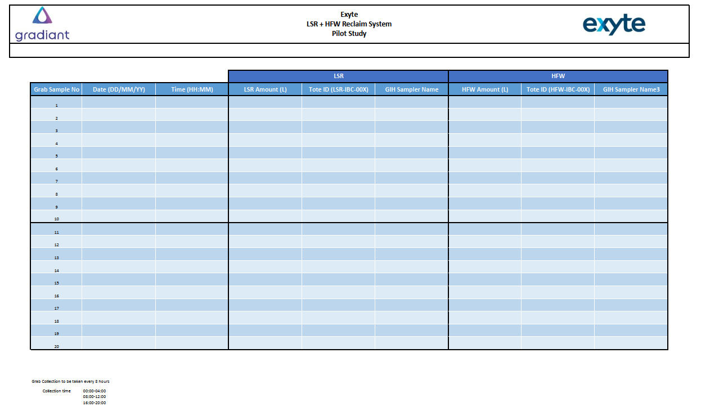
Sampling Log

Slide 13
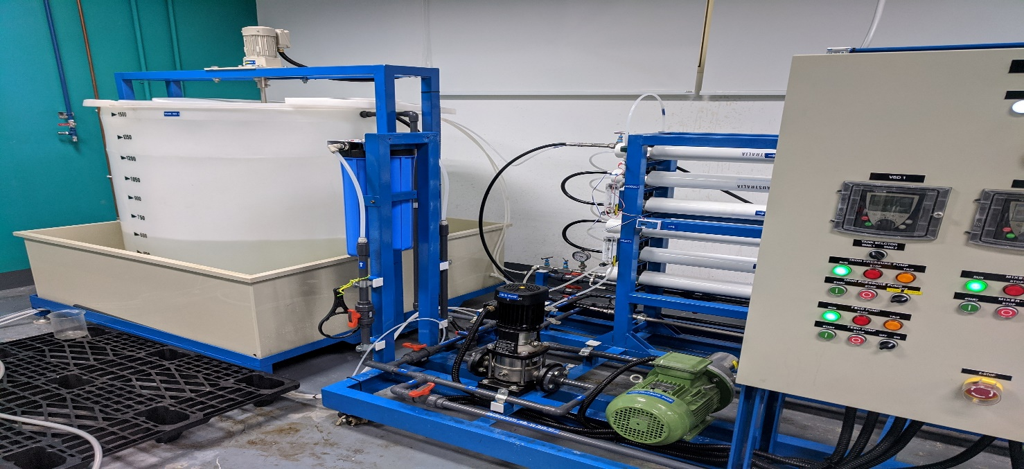
Test Setup
Control Panel
Feed Tank
Membrane
Micron filters (CF & ACF)
Pressure Gauge
Feed Pump
HP Pump

Slide 14
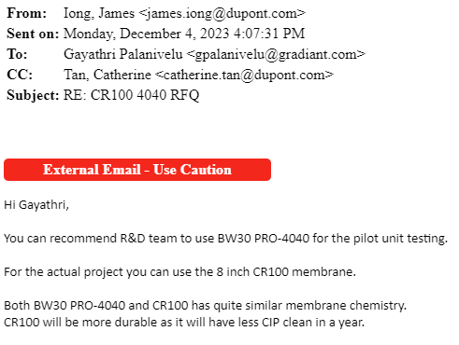
Membrane
Filmtec™ BW30 PRO-4040 PILOT
Active Area: 85 sqft (7.9 m2)
Permeate Flow: 2600 gpd
Min Rejection: 99.5%
Lenth: 40”
Diameter: 3.9”
Fortilife™ CR100-4040 PILOT
Active Area: 78 sqft (7.25 m2)
Permeate Flow: 2400 gpd
Min Rejection: 99.4%
Lenth: 40”
Diameter: 3.9”

Slide 15
Test Run
Run 1
1-2 m3 of mixed LSR + HFW
Continuous Semi-batch Operation
3-6 hours within 1 day
Feed Rate: 0.4 m3/hr
Run 2
4-8 m3 of mixed LSR + HFW
Daily Semi-batch Operation
3-6 hours daily for 4 days
Feed Rate: 0.4 m3/hr

Slide 16
Data Collected
ROI Feed Pressure over Time
ROI Effluent Conductivity over Time
ROI Reject Concentration over time
Sample of Combined Effluent water
Sample of Combined Reject water

Slide 17
Analysis
Design Basis will be updated accordingly to the test
Update RO Projection
Update Antiscalant Projection

Slide 18
Schedule
Event | Description | Date
01 | Pilot Readiness | 25-Jan
02 | Sample Collection at Site | 18-Jan to 25-Jan
03 | Micron/Exyte witness | 01-Feb
04 | Pilot Operation | 26-Jan to 08-Feb
05 | Report Preparation | 09-Feb to 22-Feb
06 | Draft Submission Review | 23-Feb to 07-Mar
07 | Final Report Submission | 08-Mar to 15-Mar

Slide 19


